Slide 1
DATA MINING LECTURE 10
Classification
k-nearest neighbor classifier
Naïve Bayes

Slide 2
NEAREST NEIGHBOR CLASSIFICATION

Slide 3
Illustrating Classification Task

Slide 4
Instance-Based Classifiers
Store the training records
Use training records to predict the class label of unseen cases

Slide 5
Instance Based Classifiers
Examples:
Rote-learner
Memorizes entire training data and performs classification only if attributes of record match one of the training examples exactly
Nearest neighbor classifier
Uses k “closest” points (nearest neighbors) for performing classification

Slide 6
Nearest Neighbor Classifiers
Basic idea:
“If it walks like a duck, quacks like a duck, then it’s probably a duck”
Compute Distance
Test Record
Training Records
Choose k of the “nearest” records

Slide 7
Nearest-Neighbor Classifiers
Requires three things
The set of stored records
Distance Metric to compute distance between records
The value of k, the number of nearest neighbors to retrieve
To classify an unknown record:
Compute distance to other training records
Identify k nearest neighbors
Use class labels of nearest neighbors to determine the class label of unknown record (e.g., by taking majority vote)

Slide 8
Definition of Nearest Neighbor
K-nearest neighbors of a record x are data points that have the k smallest distance to x

Slide 9
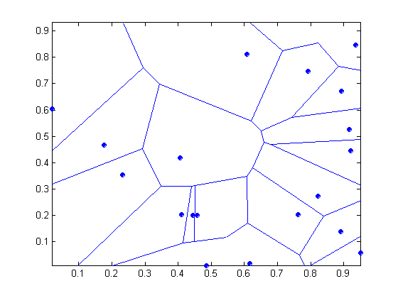
1 nearest-neighbor
Voronoi Diagram defines the classification boundary
The area takes the class of the green point

Slide 10
Nearest Neighbor Classification
Compute distance between two points:
Euclidean distance
Determine the class from nearest neighbor list
take the majority vote of class labels among the k-nearest neighbors
Weigh the vote according to distance
weight factor, w = 1/d²

Slide 11
Nearest Neighbor Classification…
Choosing the value of k:
If k is too small, sensitive to noise points
If k is too large, neighborhood may include points from other classes

Slide 12
Nearest Neighbor Classification…
Scaling issues
Attributes may have to be scaled to prevent distance measures from being dominated by one of the attributes
Example:
height of a person may vary from 1.5m to 1.8m
weight of a person may vary from 90lb to 300lb
income of a person may vary from $10K to $1M

Slide 13
Nearest Neighbor Classification…
Problem with Euclidean measure:
High dimensional data
curse of dimensionality
Can produce counter-intuitive results
1 1 1 1 1 1 1 1 1 1 1 0
1 0 0 0 0 0 0 0 0 0 0 0
vs
0 1 1 1 1 1 1 1 1 1 1 1
0 0 0 0 0 0 0 0 0 0 0 1
d = 1.4142
d = 1.4142
Solution: Normalize the vectors to unit length

Slide 14
Nearest neighbor Classification…
k-NN classifiers are lazy learners
It does not build models explicitly
Unlike eager learners such as decision trees
Classifying unknown records are relatively expensive
Naïve algorithm: O(n)
Need for structures to retrieve nearest neighbors fast.
The Nearest Neighbor Search problem.

Slide 15
Nearest Neighbor Search
Two-dimensional kd-trees
A data structure for answering nearest neighbor queries in R²
kd-tree construction algorithm
Select the x or y dimension (alternating between the two)
Partition the space into two with a line passing from the median point
Repeat recursively in the two partitions as long as there are enough points

Slide 16
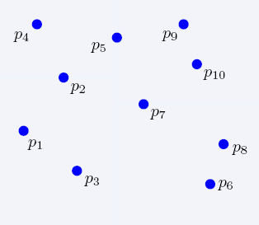
Nearest Neighbor Search
2-dimensional kd-trees

Slide 17
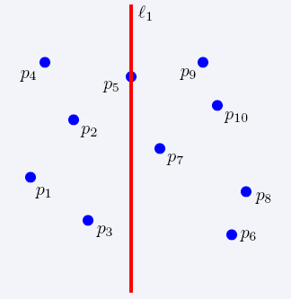
Nearest Neighbor Search
2-dimensional kd-trees

Slide 18
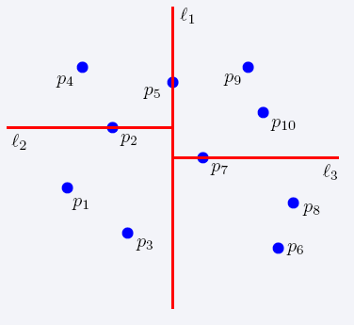
Nearest Neighbor Search
2-dimensional kd-trees

Slide 19
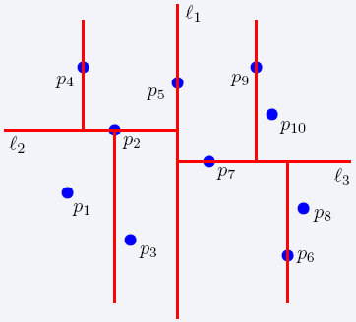
Nearest Neighbor Search
2-dimensional kd-trees

Slide 20
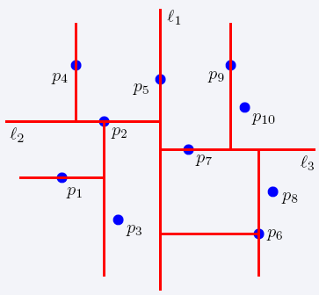
Nearest Neighbor Search
2-dimensional kd-trees

Slide 21
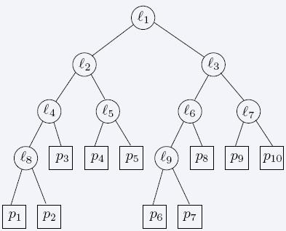
Nearest Neighbor Search
2-dimensional kd-trees

Slide 22
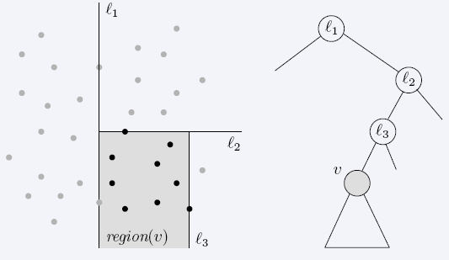
Nearest Neighbor Search
2-dimensional kd-trees
region(u) – all the black points in the subtree of u

Slide 23
Nearest Neighbor Search
2-dimensional kd-trees
A binary tree:
Size O(n)
Depth O(logn)
Construction time O(nlogn)
Query time: worst case O(n), but for many cases O(logn)
Generalizes to d dimensions
Example of Binary Space Partitioning

Slide 24
SUPPORT VECTOR MACHINES

Slide 25
Support Vector Machines
Find a linear hyperplane (decision boundary) that will separate the data

Slide 26
Support Vector Machines
One Possible Solution

Slide 27
Support Vector Machines
Another possible solution

Slide 28
Support Vector Machines
Other possible solutions

Slide 29
Support Vector Machines
Which one is better? B1 or B2?
How do you define better?

Slide 30
Support Vector Machines
What if the problem is not linearly separable?

Slide 31

Support Vector Machines
What if the problem is not linearly separable?
$$\frac{ξ_{i}}{\left\|w\right\|}$$

Slide 32
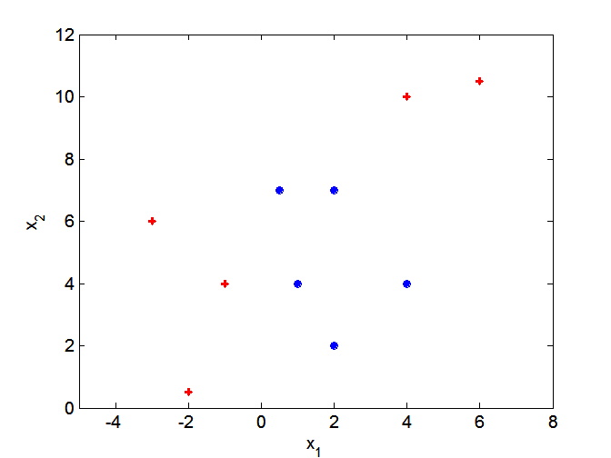
Nonlinear Support Vector Machines
What if decision boundary is not linear?

Slide 33
NAÏVE BAYES CLASSIFIER

Slide 34
Bayes Classifier
A probabilistic framework for solving classification problems
A, C random variables
Joint probability: Pr(A=a,C=c)
Conditional probability: Pr(C=c | A=a)
Relationship between joint and conditional probability distributions
Bayes Theorem:

Slide 35
Bayesian Classifiers
Consider each attribute and class label as random variables
Evade C
Event space: {Yes, No}
P(C) = (0.3, 0.7)
Refund A₁
Event space: {Yes, No}
P(A₁) = (0.3,0.7)
Martial Status A₂
Event space: {Single, Married, Divorced}
P(A₂) = (0.4,0.4,0.2)
Taxable Income A₃
Event space: R
P(A₃) ~ Normal(μ,σ)

Slide 36
Bayesian Classifiers
Given a record X over attributes (A₁, A₂,…,A_{n})
E.g., X = (‘Yes’, ‘Single’, 125K)
The goal is to predict class C
Specifically, we want to find the value c of C that maximizes P(C=c| X)
Maximum Aposteriori Probability estimate
Can we estimate P(C| X) directly from data?
This means that we estimate the probability for all possible values of the class variable.

Slide 37
Bayesian Classifiers
Approach:
compute the posterior probability P(C | A₁, A₂, …, A_{n}) for all values of C using the Bayes theorem
Choose value of C that maximizes P(C | A₁, A₂, …, A_{n})
Equivalent to choosing value of C that maximizes P(A₁, A₂, …, A_{n}|C) P(C)
How to estimate P(A₁, A₂, …, A_{n} | C )?

Slide 38
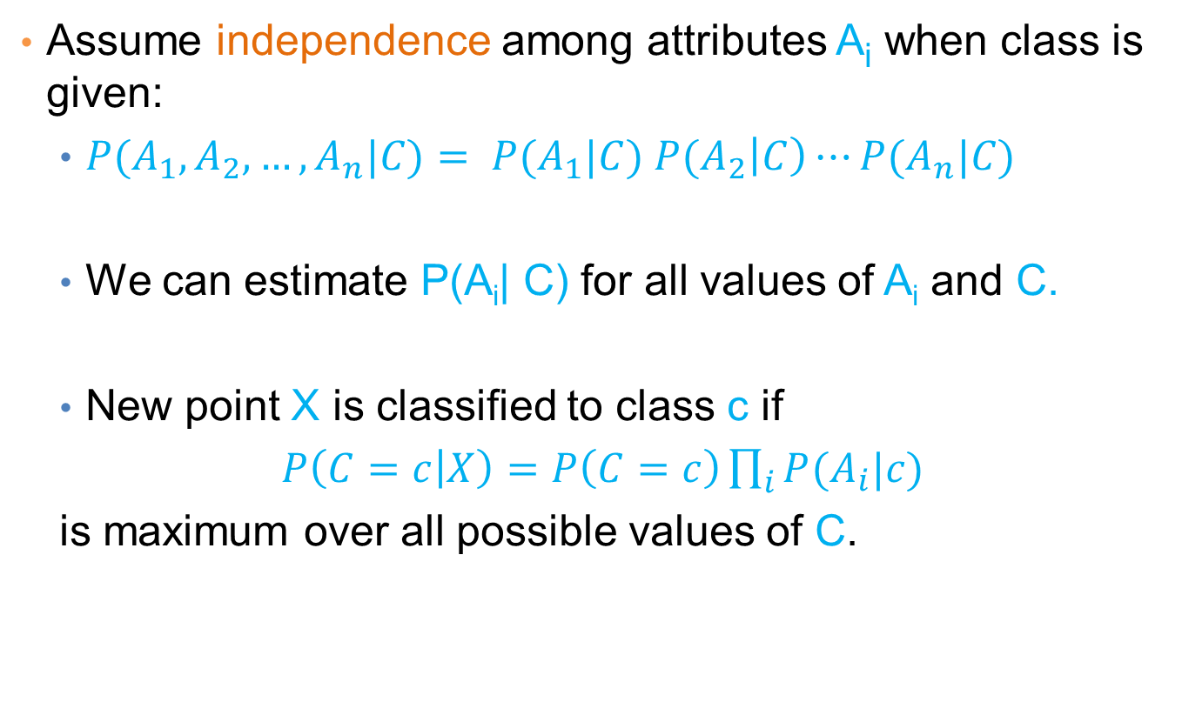
Naïve Bayes Classifier
Assume independence among attributes A_{i} when class is given:
$P(A_{1},A_{2},…,A_{n}|C)= P(A_{1}|C) P(A_{2}\left|C\right)⋯P(A_{n}|C)$
We can estimate P(A_{i}| C) for all values of A_{i} and C.
New point X is classified to class c if
$P\left(C=c | X\right)=P\left(C=c\right)\prod_{i}{P(A_{i}|c)}$
is maximum over all possible values of C.

Slide 39
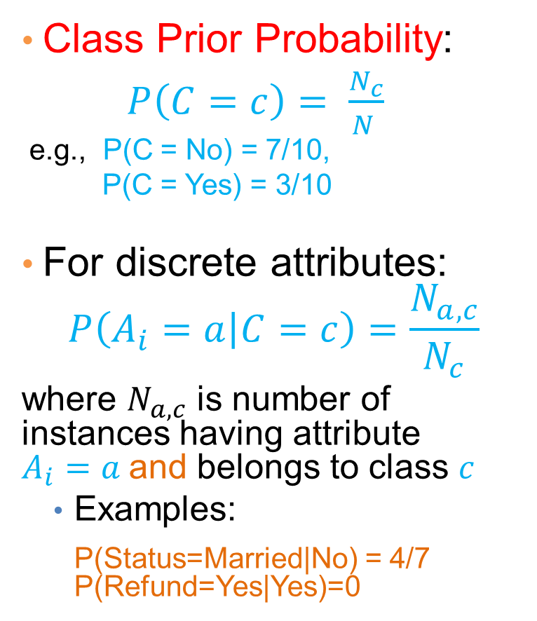
How to Estimate Probabilities from Data?
Class Prior Probability:
$P\left(C=c\right)= \frac{N_{c}}{N }$
e.g., P(C = No) = 7/10,
P(C = Yes) = 3/10
For discrete attributes:
$$P\left(A_{i}=a | C=c\right)=\frac{N_{a,c}}{N_{c}}$$
where $N_{a,c}$ is number of instances having attribute $A_{i}=a$and belongs to class $c$
Examples:
P(Status=Married|No) = 4/7 P(Refund=Yes|Yes)=0

Slide 40
How to Estimate Probabilities from Data?
For continuous attributes:
Discretize the range into bins
one ordinal attribute per bin
violates independence assumption
Two-way split: (A < v) or (A > v)
choose only one of the two splits as new attribute
Probability density estimation:
Assume attribute follows a normal distribution
Use data to estimate parameters of distribution (i.e., mean μ and standard deviation σ)
Once probability distribution is known, we can use it to estimate the conditional probability P(A_{i}|c)

Slide 41
How to Estimate Probabilities from Data?
Normal distribution:
One for each (a_{i},c_{i}) pair
For (Income, Class=No):
If Class=No
sample mean = 110
sample variance = 2975

Slide 42
Example of Naïve Bayes Classifier
Creating a Naïve Bayes Classifier, essentially means to compute counts:
Total number of records: N = 10
Class No:
Number of records: 7
Attribute Refund:
Yes: 3
No: 4
Attribute Marital Status:
Single: 2
Divorced: 1
Married: 4
Attribute Income:
mean: 110
variance: 2975
Class Yes:
Number of records: 3
Attribute Refund:
Yes: 0
No: 3
Attribute Marital Status:
Single: 2
Divorced: 1
Married: 0
Attribute Income:
mean: 90
variance: 25

Slide 43
Example of Naïve Bayes Classifier
Given a Test Record:
P(X|Class=No) = P(Refund=No|Class=No) × P(Married| Class=No) × P(Income=120K| Class=No) = 4/7 × 4/7 × 0.0072 = 0.0024
P(X|Class=Yes) = P(Refund=No| Class=Yes) × P(Married| Class=Yes) × P(Income=120K| Class=Yes) = 1 × 0 × 1.2 × 10⁻⁹ = 0
P(No) = 0.3, P(Yes) = 0.7
Since P(X|No)P(No) > P(X|Yes)P(Yes)
Therefore P(No|X) > P(Yes|X) => Class = No

Slide 44
Naïve Bayes Classifier
If one of the conditional probability is zero, then the entire expression becomes zero
Probability estimation:
N_{i}: number of attribute values for attribute A_{i}
p: prior probability
m: parameter

Slide 45
Example of Naïve Bayes Classifier
Given a Test Record:
With Laplace Smoothing
P(X|Class=No) = P(Refund=No|Class=No) × P(Married| Class=No) × P(Income=120K| Class=No) = 5/9 × 5/10 × 0.0072
P(X|Class=Yes) = P(Refund=No| Class=Yes) × P(Married| Class=Yes) × P(Income=120K| Class=Yes) = 4/5 × 1/6 × 1.2 × 10⁻⁹
P(No) = 0.7, P(Yes) = 0.3
Since P(X|No)P(No) > P(X|Yes)P(Yes)
Therefore P(No|X) > P(Yes|X) => Class = No

Slide 46
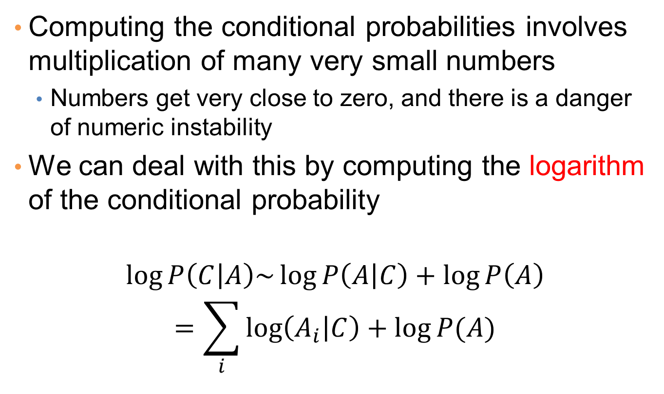
Implementation details
Computing the conditional probabilities involves multiplication of many very small numbers
Numbers get very close to zero, and there is a danger of numeric instability
We can deal with this by computing the logarithm of the conditional probability
$$\log{P\left(C | A\right)\sim \log{P\left(A | C\right)+\log{P\left(A\right)}}}$$
$$=\sum_{i}{\log\left(A_{i} | C\right)+\log{P(A)}}$$

Slide 47
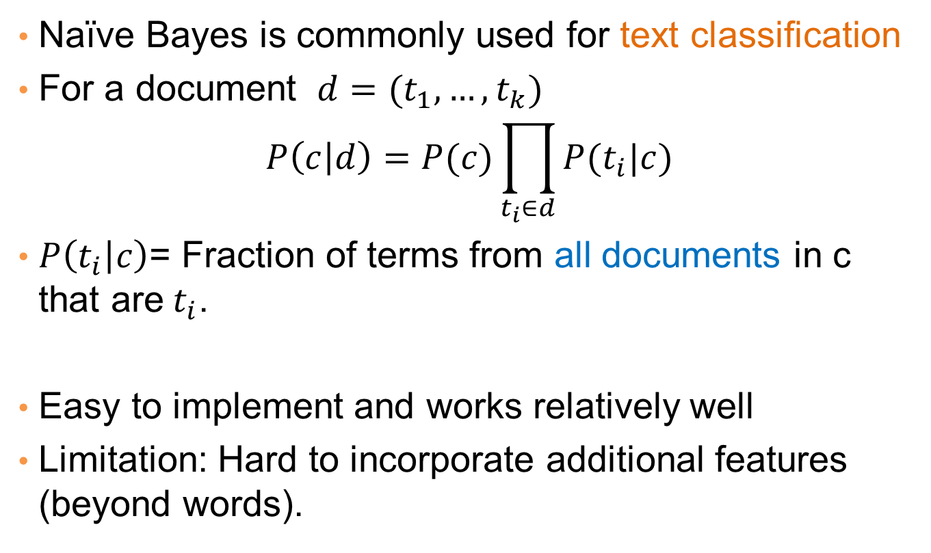
Naïve Bayes for Text Classification
Naïve Bayes is commonly used for text classification
For a document $d=(t_{1},…, t_{k})$
$$P\left(c | d\right)=P(c)\prod_{t_{i}∈d}{P(t_{i}|c)}$$
$P\left(t_{i} | c\right)$= Fraction of terms from all documents in c that are$t_{i}$.
Easy to implement and works relatively well
Limitation: Hard to incorporate additional features (beyond words).

Slide 48
Naïve Bayes (Summary)
Robust to isolated noise points
Handle missing values by ignoring the instance during probability estimate calculations
Robust to irrelevant attributes
Independence assumption may not hold for some attributes
Use other techniques such as Bayesian Belief Networks (BBN)
Naïve Bayes can produce a probability estimate, but it is usually a very biased one
Logistic Regression is better for obtaining probabilities.

